Slide 1




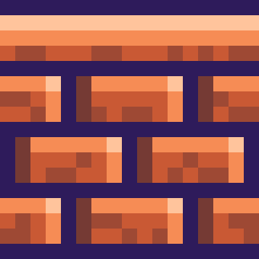
WELCOME!

Slide 2




GROUP 17 MEMBERS:
1.Pham Nguyen Tien Dat
2.Trinh Binh Nguyen
3.Phan Nguyen Hung Cuong
4.Le Trung Kien
5.Duong Nhat Huy

Slide 3
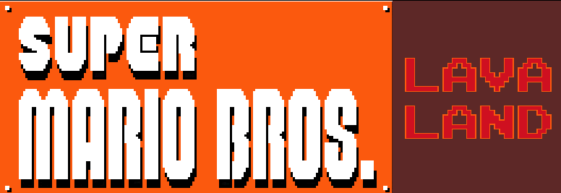
GROUP 17

Slide 4

01.
INTRODUCTION
02.
IMPROVEMENTS
03.
CONCLUSION

Slide 5
01.
INTRODUCTION

Slide 6
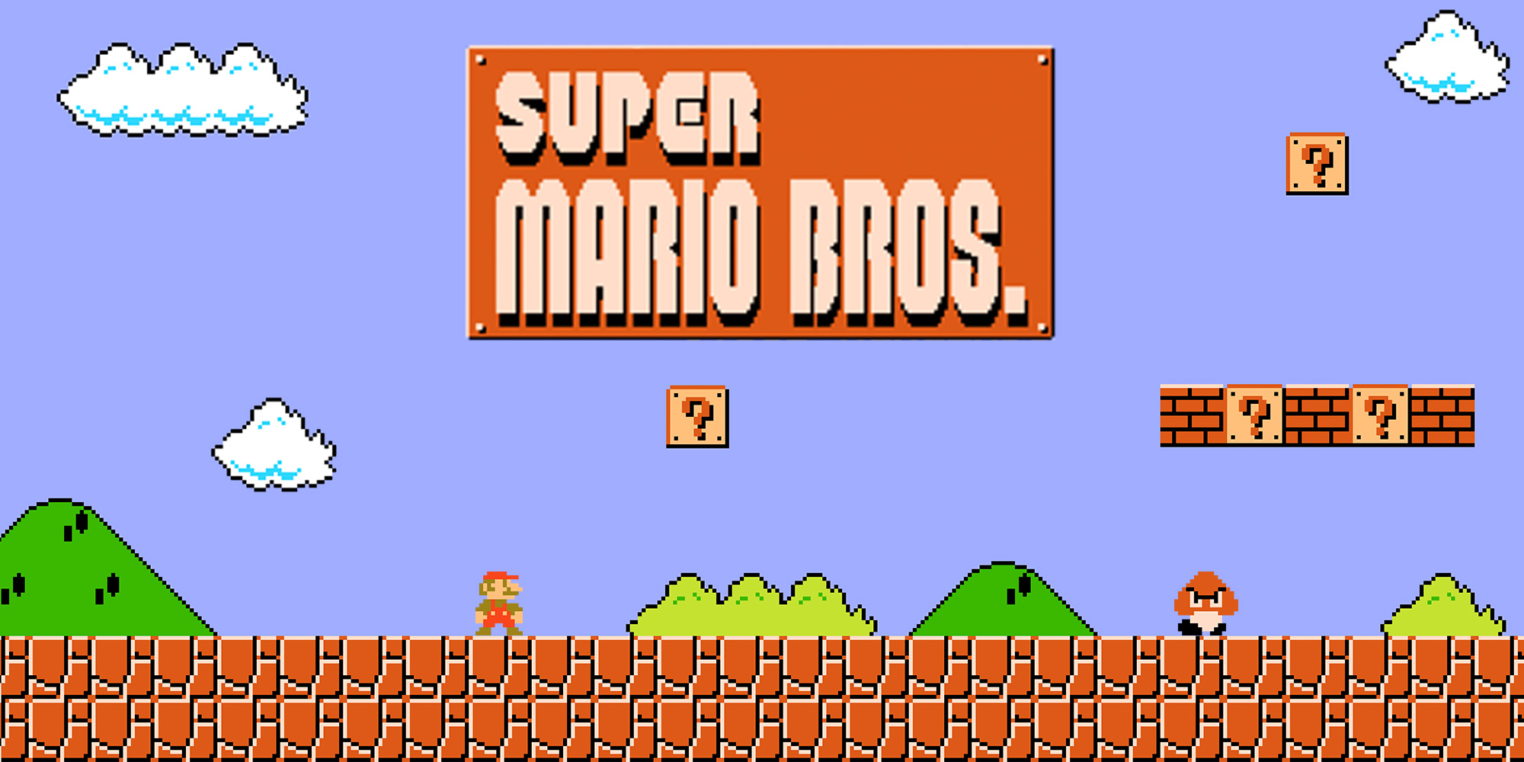

Slide 8
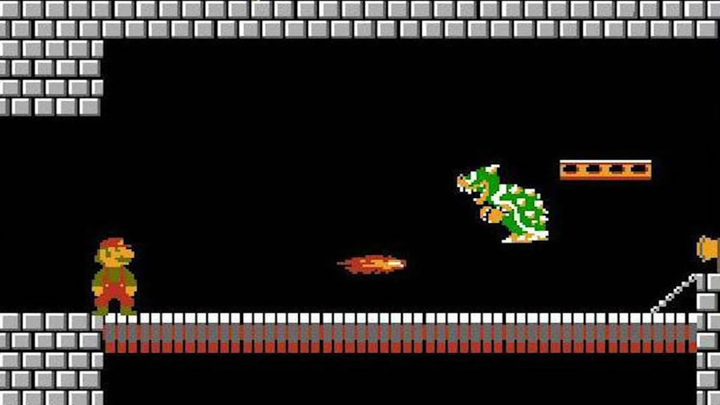

Slide 9
02.
IMPROVEMENTS

Slide 10
USER INTERFACE

Slide 11
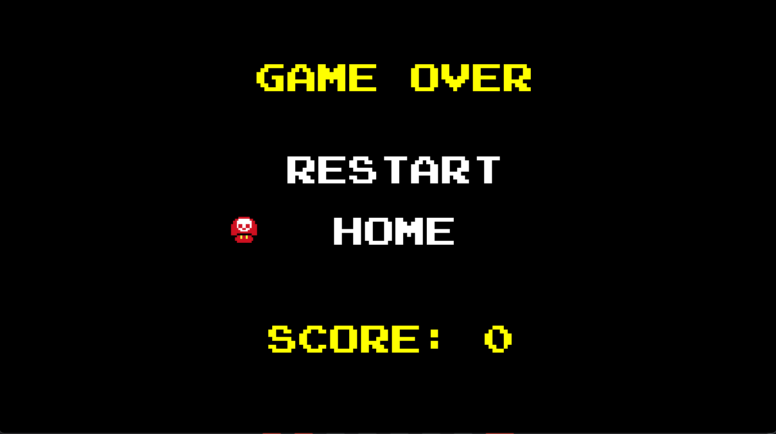

Slide 12
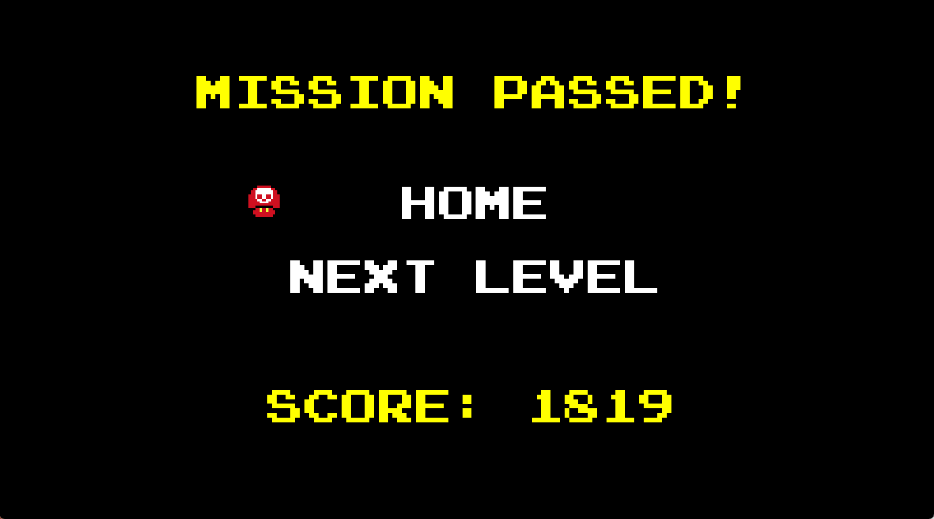

Slide 13
NEW CHALLENGES

Slide 14
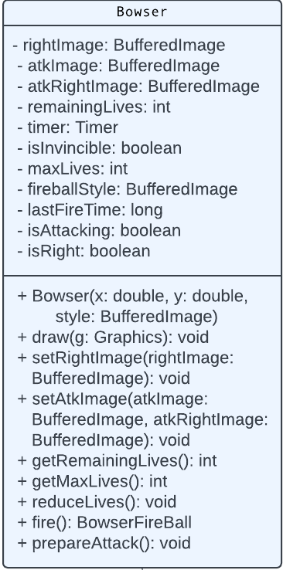


Slide 15
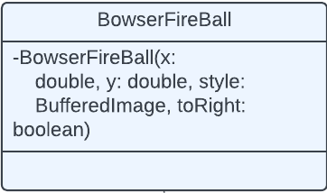


Slide 17
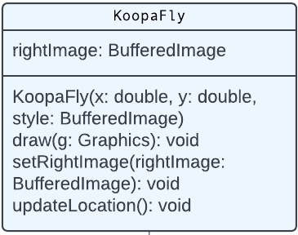

Slide 18
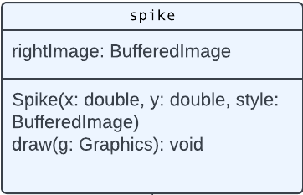

Slide 19
DESIGN
&SFX

Slide 20
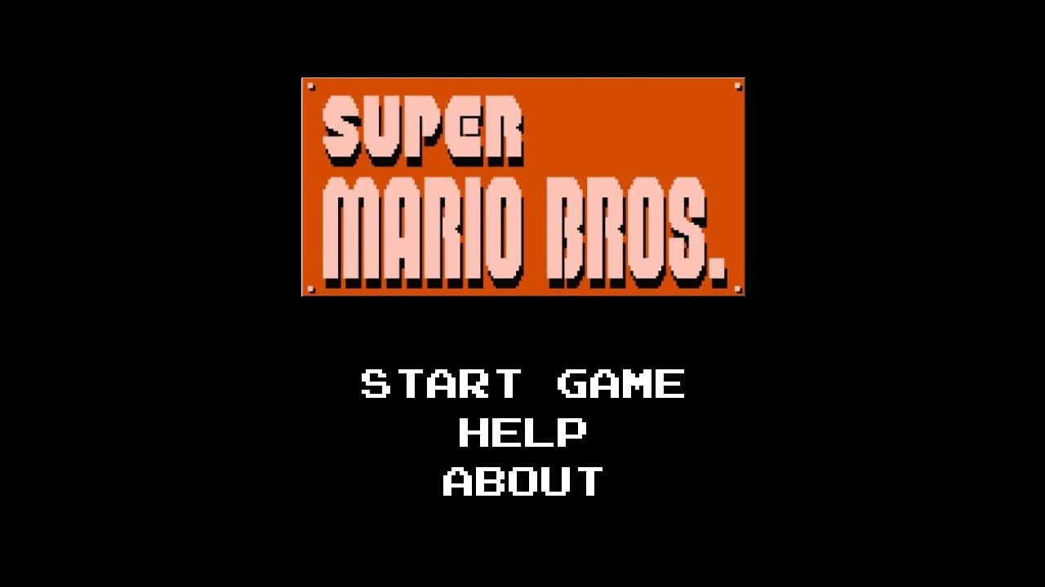

Slide 21
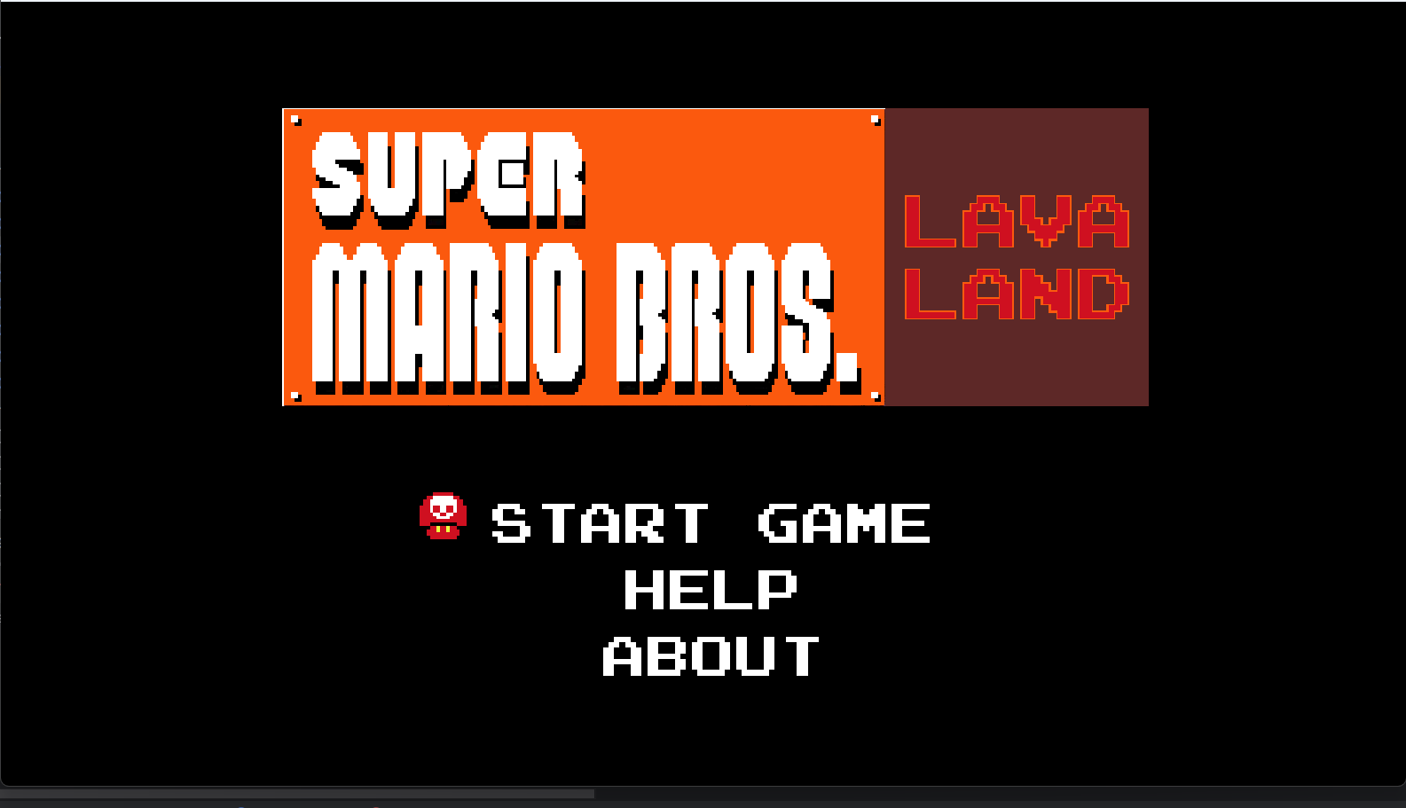

Slide 23
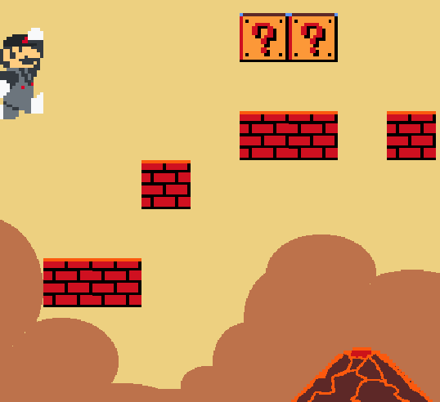
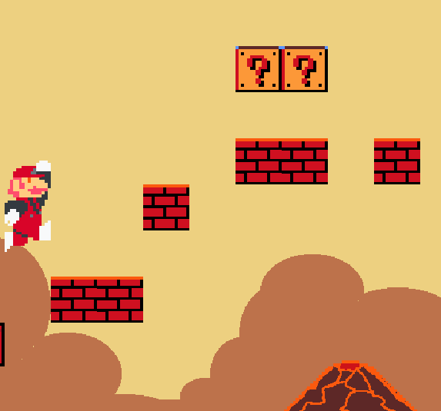

Slide 24



Slide 25
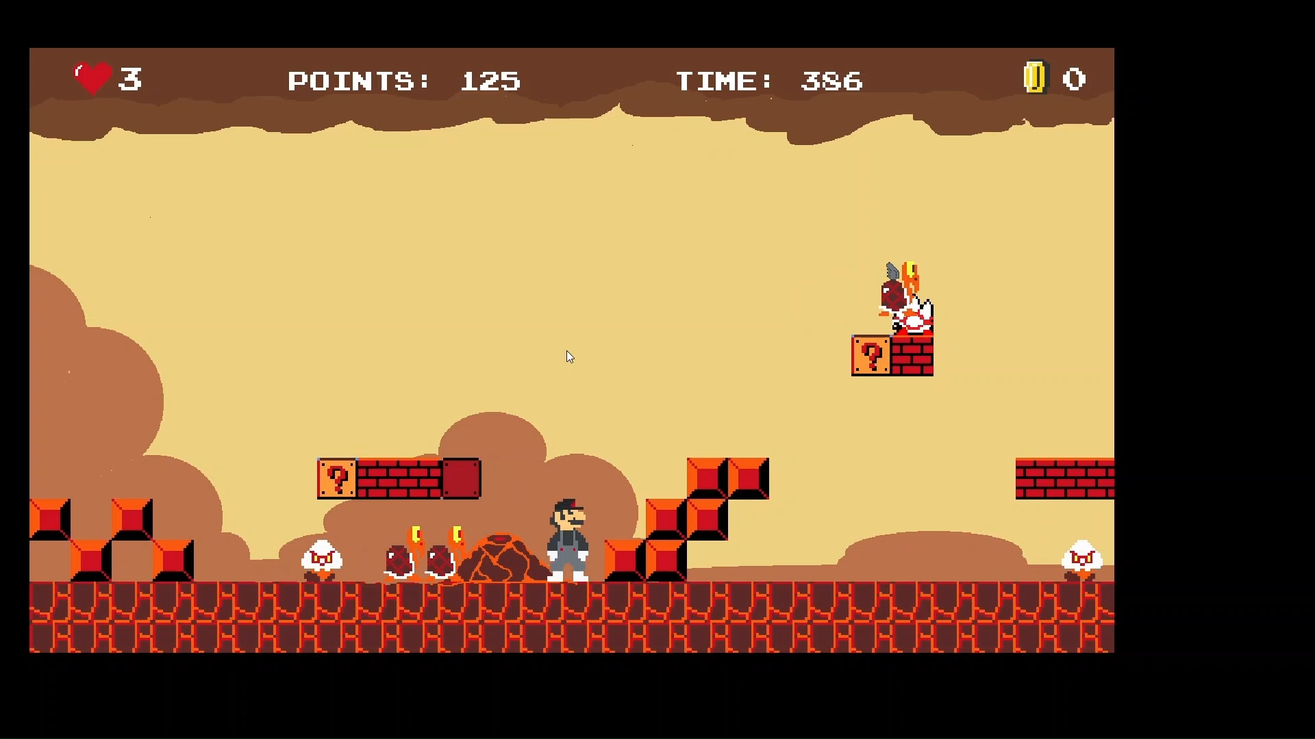

Slide 26
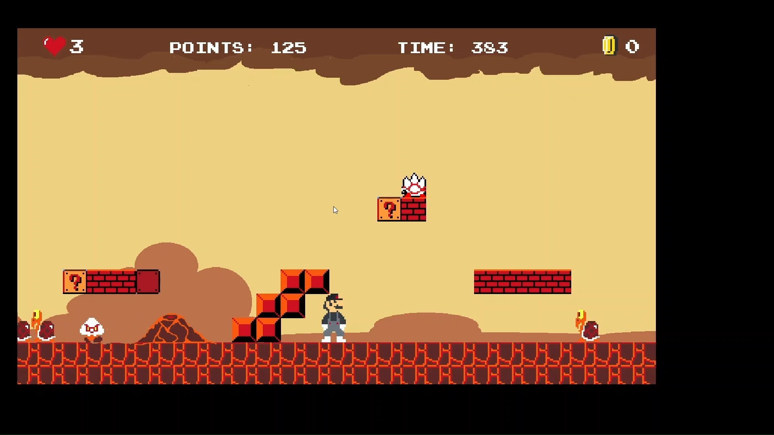

Slide 27
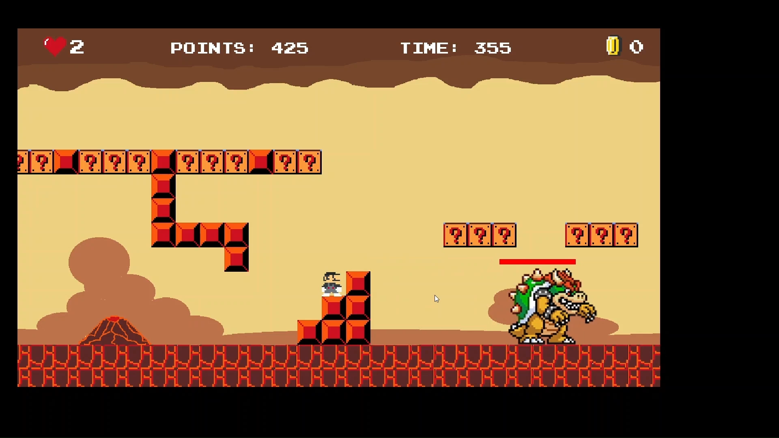

Slide 28
03.
GAMEPLAY

Slide 29
03.
OOP CONCEPT

Slide 30
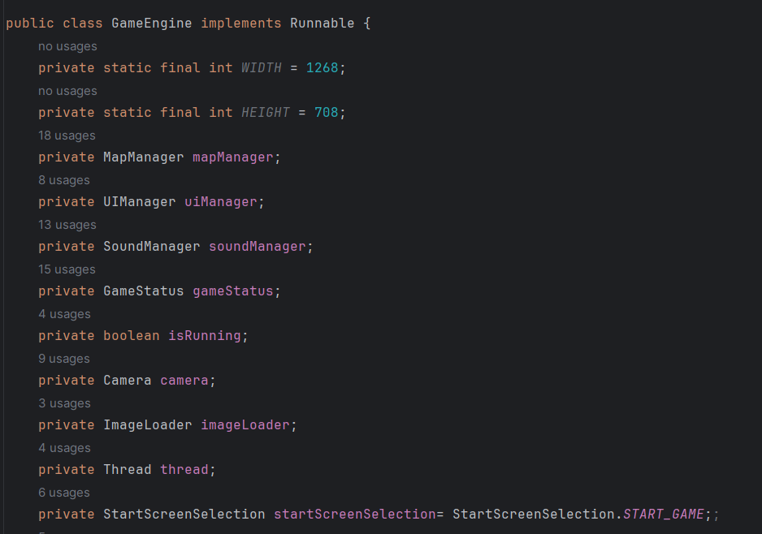
ENCAPSULATION

Slide 31
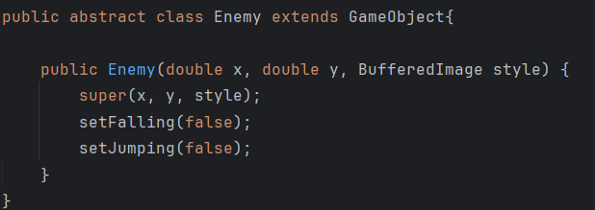
POLYMORPHISM

Slide 32
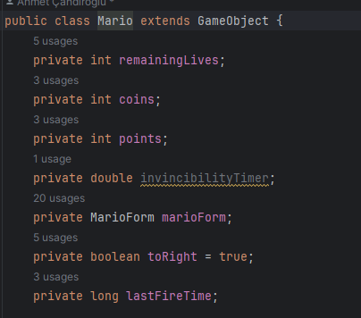
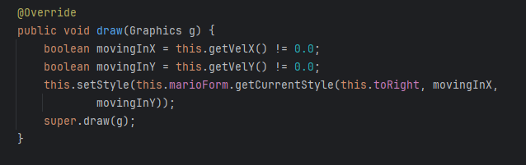
INHERITANCE

Slide 33
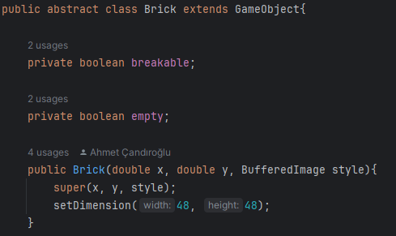
ABSTRACT

Slide 34
04.
CONCLUSION

Slide 35
01.
ACHIEVED GOALS
Comprehensive OOP Integration
Intuitive User Interface Development
Optimized Performance Strategies

Slide 36

02.
LIMITATIONS
Limited Map Variety
Limited Game Complexity
Non-Adherence to S.O.L.I.D. Principles

Slide 37

03.
FUTURE ENHANCEMENTS
Multiplayer Mode
New Bosses and Obstacles
Shopping Items

Slide 38
REFERENCES
Candiroglu, Ahmet. “Classic Super Mario Bros. game implemented with Java for CS319 course.” GitHub, https://github.com/ahmetcandiroglu/Super-Mario-Bros. Accessed 18 Jan. 20241.
Baker, Ben. “Super Mario’s First 14 Video Games (in Chronological Order).” TheGamer, 23 Feb. 2021, www.thegamer.com/super-mario-first-games-chronological-ranked/#mario-bros-game-amp-watch.
Fakhroutdinov, Kirill. “Dependency in UML.” UML Graphical Notation Overview, Examples, and Reference., www.uml-diagrams.org/dependency.html. Accessed 18 Jan. 2024.
Biniasz, Kyle. “What Are OOP Concepts in Java? 4 Primary Concepts.” Stackify, 1 May 2023, stackify.com/oops-concepts-in-java/.
“Code a 2D Game Engine Using Java - Full Course for Beginners.” YouTube, YouTube, 3 Jan. 2022, https://www.youtube.com/watch?v=025QFeZfeyM&feature=youtu.be. Accessed 18 Jan. 2024.

Slide 39
THANK YOU!

